Slide 1
Week-3

Slide 2
Six Categories of Hardware: 2. Output Devices
Output devices used to hear, see, or otherwise recognize the results of information-processing requests.
An output device is any peripheral that receives data from a computer, usually for display, projection, or physical reproduction.
Most Common Output Devices:
Monitors
Graphic Plotter
Printer
Speaker (Headphones)
Rare Output Devices:
3D Printer
Braille embosser
Braille reader
Speech-generating device (SGD)

Slide 3
Monitors
Monitors, commonly called as Visual Display Unit (VDU), are the main output device of a computer.
It forms images from tiny dots, called pixels that are arranged in a rectangular form. The sharpness of the image depends upon the number of pixels.
There are two kinds of viewing screen used for monitors.
Cathode-Ray Tube (CRT)
Flat-Panel Display

Slide 4
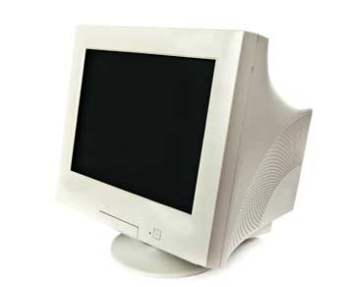
Cathode-Ray Tube (CRT) Monitor
A finite number of characters can be displayed on a screen at once.
Most screens are capable of displaying 80 characters of data horizontally and 25 lines vertically.
There are some disadvantages of CRT:
Large in Size
High power consumption

Slide 5
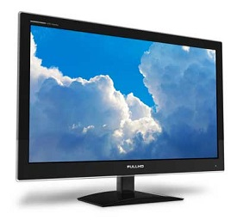
Flat-Panel Display Monitor
The flat-panel display refers to a class of video devices that have reduced volume, weight and power requirement in comparison to the CRT.
You can hang them on walls or wear them on your wrists.
The flat-panel display is divided into two categories:
Emissive Displays: Emissive displays are devices that convert
electrical energy into light. (Plasma panel and LED)
Non-Emissive Displays: Non-emissive displays use optical
effects to convert sunlight or light from some other source
into graphics patterns. (LCD – Liquid Crystal Device)
Notes:
Emissive:
The image is produced directly on the screen
Phosphors convert electron beams or UV light into visible light.
Field emission display (FED)
Surface-conduction Electron-emitter Display (SED)c
Vacuum Fluorescent Display (VFD)
Electroluminescent Displays (ELD)
Light-Emitting Diode Displays (LED)
Plasma Display Panel (PDP)
Electrochemical Display (ECD)
Organic Light Emitting Diode (OLED)
Non-Emissive:
Light is produced behind the screen and the image is formed by filtering this light

Slide 6
Printers
Printer is an output device, which is used to print information on paper.
There are two types of printers:
Impact Printers
Non-Impact Printers

Slide 7
Impact Printers
Impact printers print the characters by striking them on the ribbon, which is then pressed on the paper.
Characteristics of Impact Printers are:
Very low consumable costs
Very noisy
Useful for bulk printing due to low cost
There is physical contact with the paper to produce an image
These printers are of two types:
Character printers
Line printers

Slide 8
Character Printers
Character printers are the printers which print one character at a time.
These are further divided into two types:
Dot Matrix Printer(DMP)
Daisy Wheel

Slide 9
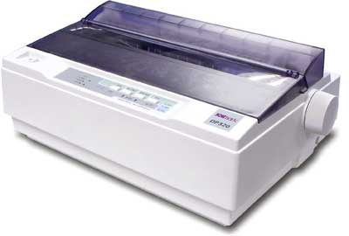
Dot Matrix Printer
One of the most popular printers is Dot Matrix Printer.
Each character printed is in the form of pattern of dots and head consists of a Matrix of Pins of size (5*7, 7*9, 9*7 or 9*9) which come out to form a character which is why it is called Dot Matrix Printer.
Advantages
Inexpensive
Widely Used
Other language characters can be printed
Disadvantages
Slow Speed
Poor Quality

Slide 10
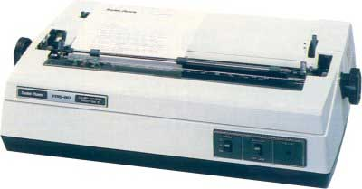
Daisy Wheel
Head is lying on a wheel and pins corresponding to characters are like petals of Daisy (flower) which is why it is called Daisy Wheel Printer.
These printers are generally used for word-processing in offices that require a few letters to be sent here and there with very nice quality.
Advantages
More reliable than DMP
Better quality
Fonts of character can be easily changed
Disadvantages
Slower than DMP
Noisy
More expensive than DMP

Slide 11
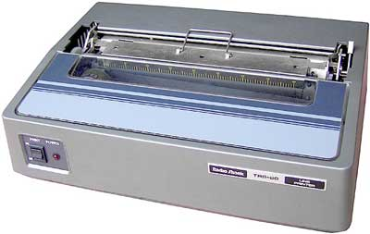
Line Printers
Line printers are the printers which print one line at a time.
These are of two types:
Drum Printer
Chain Printer

Slide 12
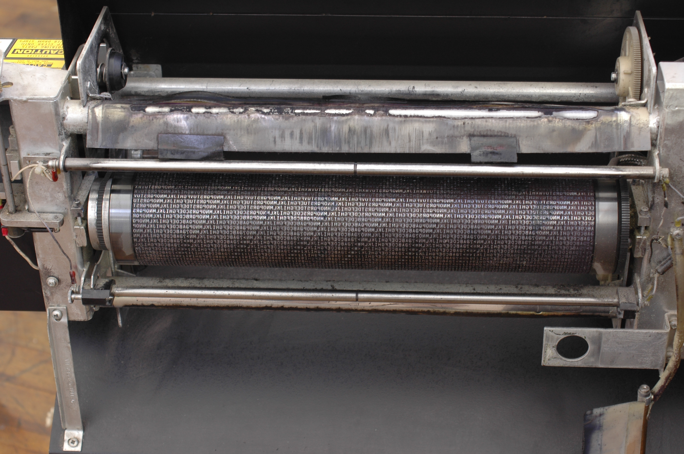
Drum Printer
This printer is like a drum in shape hence it is called drum printer.
The surface of the drum is divided into a number of tracks. Total tracks are equal to the size of the paper.
for a paper width of 132 characters, drum will have 132 tracks.
A character set is embossed on the track.
Different character sets available (48 character set, 64 and 96 characters)
One rotation of drum prints one line.
Advantages
Very high speed
Disadvantages
Very expensive
Characters fonts cannot be changed

Slide 13
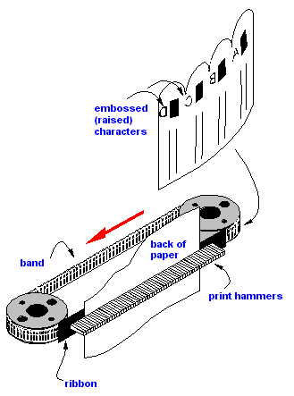
Chain Printer
In this printer, a chain of character sets is used, hence it is called Chain Printer.
A standard character set may have 48, 64, or 96 characters.
Advantages
Character fonts can easily be changed.
Different languages can be used with the same printer.
Disadvantages
Noisy

Slide 14
Non-impact Printers
Non-impact printers print the characters without using the ribbon.
These printers print a complete page at a time, thus they are also called as Page Printers.
These printers are of two types:
Laser Printers
Inkjet Printers
Characteristics of Non-impact Printers
Faster than impact printers
They are not noisy
High quality
Supports many fonts and different character size

Slide 15
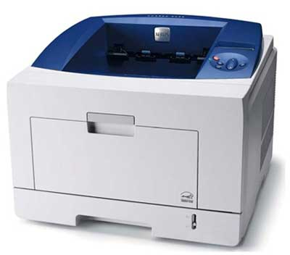
Laser Printers
They use laser lights to produce the dots needed to form the characters to be printed on a page.
Advantages
Very high speed
Very high quality output
Good graphics quality
Supports many fonts and different character size
Disadvantages
Expensive
Cannot be used to produce multiple copies of a document in a single printing

Slide 16
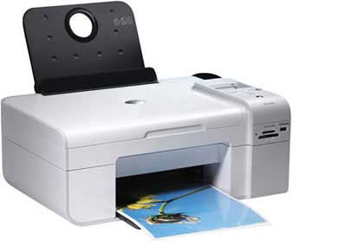
Inkjet Printers
They print characters by spraying small drops of ink onto paper.
Inkjet printers produce high quality output with presentable features.
Advantages
High quality printing
More reliable
Disadvantages
Expensive as the cost per page is high
Slow as compared to laser printer

Slide 17
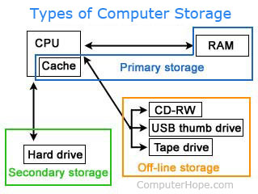
Six Categories of Hardware: 3. Storage Devices
Storage devices used to store information for use at a later time (magnetic, optical, flash).
Alternatively referred to as external memory, secondary memory, and auxiliary storage, a secondary storage device is a non-volatile device that holds data until it is deleted or overwritten.
Hard drive
Solid-state drive
USB thumb drive
SD card
CD
DVD
Floppy diskette
Tape drive

Slide 18
Hard Disk Drive
A hard disk drive (sometimes abbreviated as hard drive, HD, or HDD) is a non-volatile memory hardware device that permanently stores and retrieves data on a computer.
Consists of one or more platters to which data is written using a magnetic head, all inside of an air-sealed casing.
Four types of connection for HDD:
PATA (ATA, IDE, ATAPI): Parallel Advanced Technology Attachment
SATA : Serial ATA
SCSI : Small Computer System Interface
SAS: Serial Atached SCSI

Slide 19
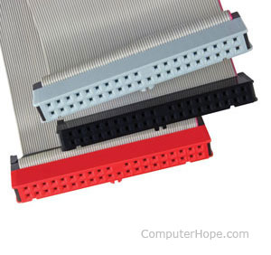
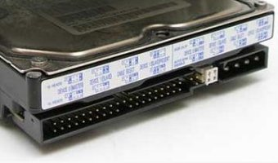
PATA
Known as IDE, ATAPI or ATA harddisk.
The ATA standard is backward compatible, which means new ATA drives (excluding SATA) can be used with older ATA interfaces.
ATA 1: Transfer rate up to 8.3 MBps (1994)
ATA 2: Transfer rates of up to 16.6 MBps (1996)
ATA 3: Added additional security features (1997)
ATA 4: Transfer rates of up to 33 MBps (1998)
ATA 5: Transfer rates of up to 66 MBps (2000)
ATA 6: Transfer rate of up to 100 MBps (2001)

Slide 20
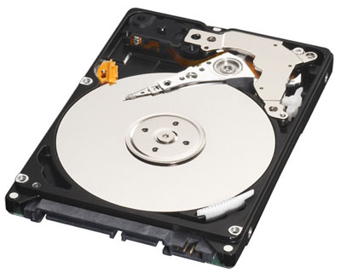
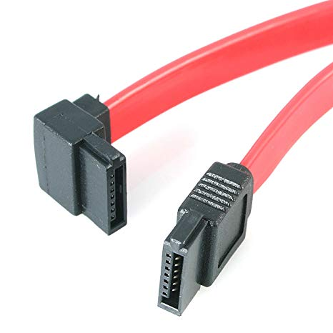
SATA
Released in August 2001 and is a replacement for the parallel ATA interface used in IBM compatible computers.
SerialATA is capable of delivering 1.5 Gbps (1500 MBps).
Seven pin data cable.

Slide 21
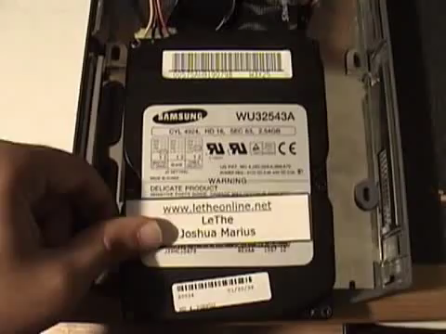
INSIDE OF HDD
Notes:
Low Density and High Density: 25-50 and 68 pin cables.

Slide 22
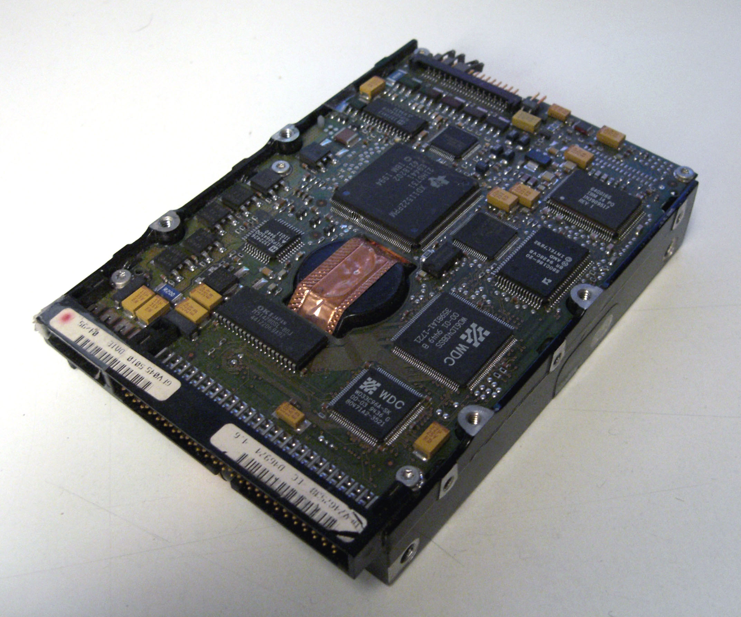
SCSI
Faster and more flexibly than previous parallel data transfer interfaces.
More expensive, more preferred on servers (server farms) for hard drive controllers.
SCSI 1: Capable of transferring up to 5MBps (1986).
SCSI 2: Capable of transferring up to 5-10MBps (1990).
SCSI 3: Capable of transferring up to 20MBps (1996).
…. The latest version Ultra-640: 640MBps (2003).
Notes:
Low Density and High Density: 25-50 and 68 pin cables.

Slide 23
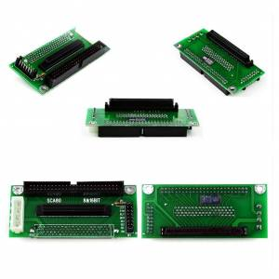
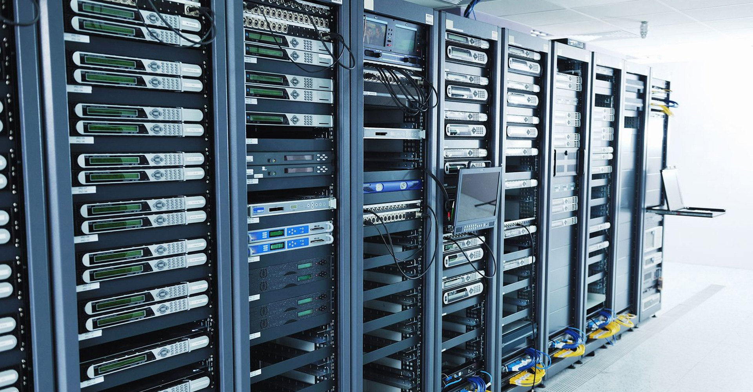
SCSI
Notes:
Low Density and High Density: 25-50 and 68 pin cables.

Slide 24
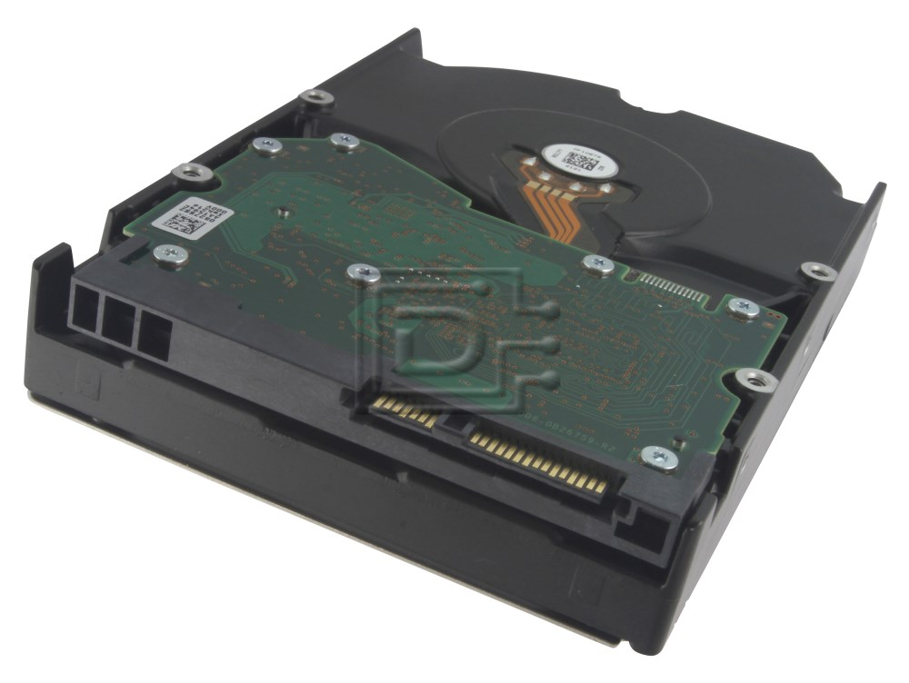
SAS (Serial Attached SCSI)
SAS is a performance improvement over traditional SCSI.
SAS enables multiple devices (up to 128) of different sizes and types to be connected simultaneously.
Thinner and longer cables.
Full-duplex signal transmission supports 3.0Gb/s
(3000MBps).
SAS drives can be hot-plugged.

Slide 25
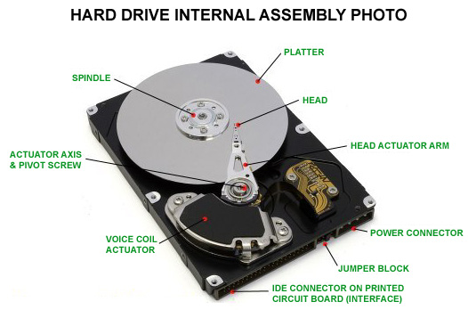
Hard Drive Components
Hard drive consists of the following components:
Head actuator,
Read/write actuator arm,
Read/write head,
Spindle motor,
Platter.
Notes:
Mekanik yapı sabit disklerin bant genişliğini sınırlamaktadır. Çünkü dönüş hızları ve eksensel hareket kabiliyetleri, elektronik yapılara göre oldukça düşüktür. Fakat veri kurtarma kabiliyeti en iyi sabit disk modellerdir. Manyetik yüzeye sahip genelde alüminyum veya seramik katkılı cam malzemeden oluşan disklere sahiptirler. Bu diskler sabit bir hızla döner. Okuma/yazma kafası dönen disk üzerindeki dosya sistemine göre hareket ederek verilen komutları icra etmeye çalışır. Manyetik yüzey eski disklerde demir oksit, şimdiki disklerde ise kobalt denilen malzeme ile kaplanır. Veriler hızla dönen diskler üzerinde arkalı önlü olarak, dijital formatta tutulmaktadır.

Slide 26
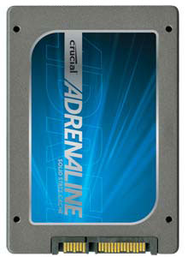
Solid State Drives (SSD)
Unlike a hard drive, an SSD has no moving parts which gives it advantages such as;
Faster access time,
Noiseless operation,
Higher reliability,
Lower power consumption.
The first SSD was implemented in the 1970s and 1980s for
use in IBM supercomputers.
Transfer speeds of up to 1.5 GB per second.

Slide 27
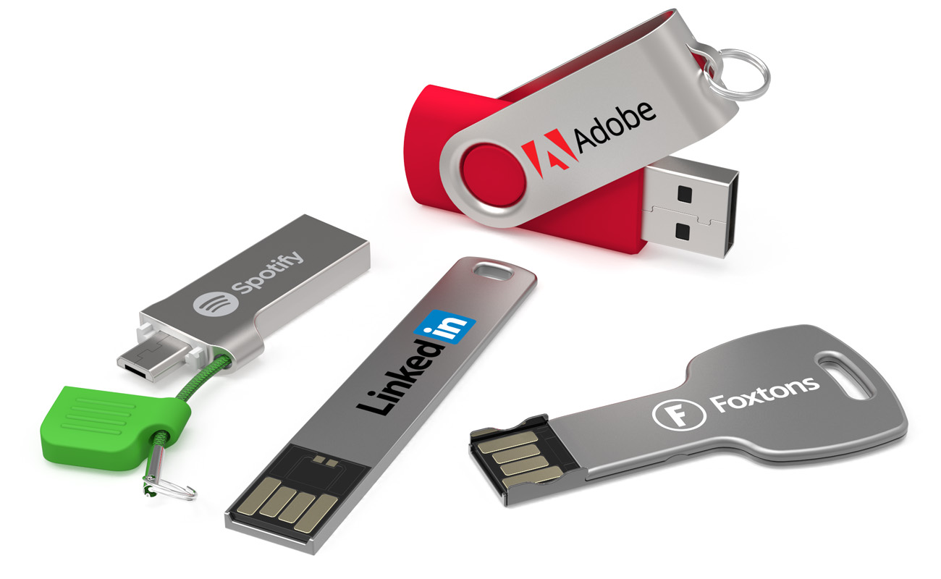
USB Thumb Drive
Alternatively referred to as a USB flash drive, data stick, pen drive, memory unit, keychain drive and thumb drive, a jump drive is a portable storage device.
Connects to a computer via a USB port.
Range in sizes from 2 GB to 1 TB.
Unlike a standard hard drive, the flash drive
has no movable parts; it contains only an integrated
circuit memory chip that is used to store data.

Slide 28
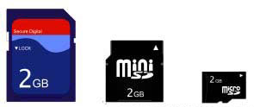
SD Card
Short for Secure Digital card, the SD card is one of the more common types of memory cards used with electronics.
The three versions of the SD card, along with their physical dimensions:
SD - 32mm x 24mm x 2.1mm.
MiniSD - 21.5mm x 20mm x 1.4mm.
MicroSD - 15mm x 11mm x 1.0mm.

Slide 29
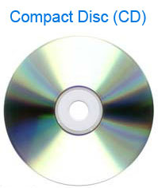
CD
Abbreviated as CD, a compact disc is a flat, round, optical storage medium.
The standard CD is capable of holding 72 minutes of music or 650 MB of data. An 80 minute CD is capable of holding 700 MB of data.

Slide 30
DVD
Short for digital versatile disc or digital video disc, a DVD or DVD-ROM is a disc capable of storing large amounts of data on one disc the size of a standard CD.
Several capacities a single DVD;
The single-sided, single-layer disc, capable of holding 4.7 GB.
The single-sided, double-layer disc is capable of holding between 8.5-8.7 GB.
The double-sided, single-layer disc is capable of holding 9.4 GB.
The double-sided, double-layer disc is capable of holding up to 17.08 GB.
The future of DVD’s is Blue-Ray.

Slide 31
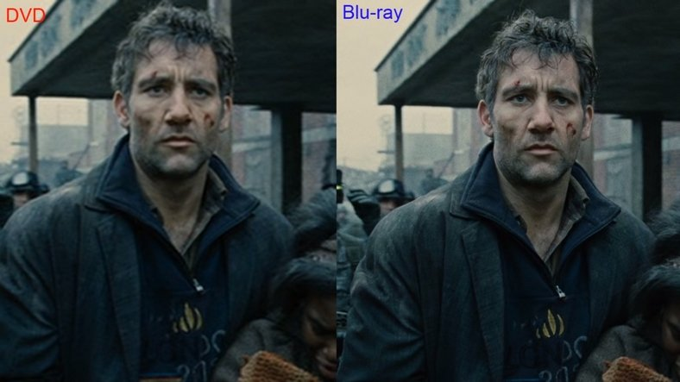
BLU RAY vs. DVD

Slide 32
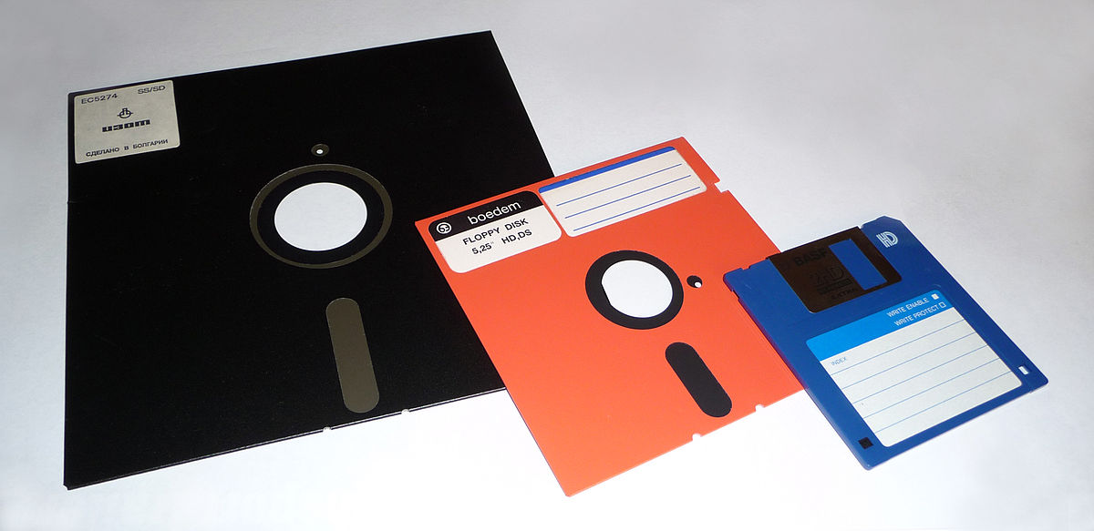
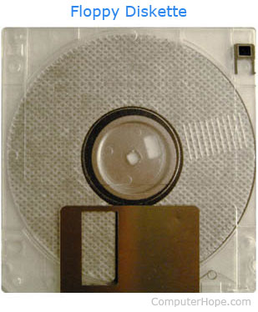
Floppy Disk
Alternatively referred to as a floppy or a floppy diskette is a type of storage media.
The floppy diskette was first created in 1967 by IBM.
Most commonly used floppy diskettes, capable of storing 1.44 MB and 3.5" size.
Notes:
8, 5.25 and 3.5 inches.

Slide 33
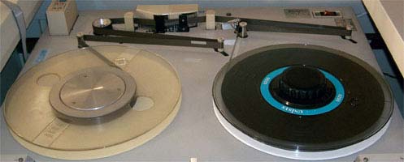
Tape Drive
A tape is a magnetically thin coated piece of plastic wrapped around wheels capable of storing data.
Tape is much less expensive than other storage mediums.
The storage capacity of a tape drive all depends on the type of tape drive and technology being used.
First tape drive introduced by Remington Rand in 1951 was only capable of storing 224 KB of data.
The IBM TS1155 generation 6 tape drive
released in 2017 is capable of storing
15 TB of uncompressed data.
Notes:
8, 5.25 and 3.5 inches.

Slide 34
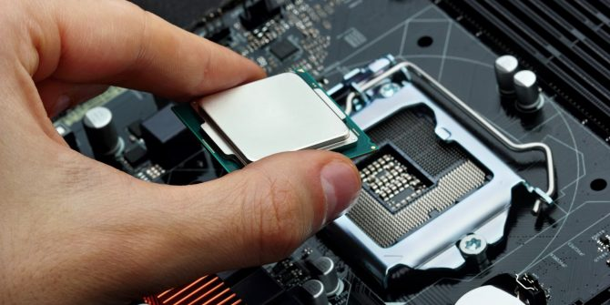
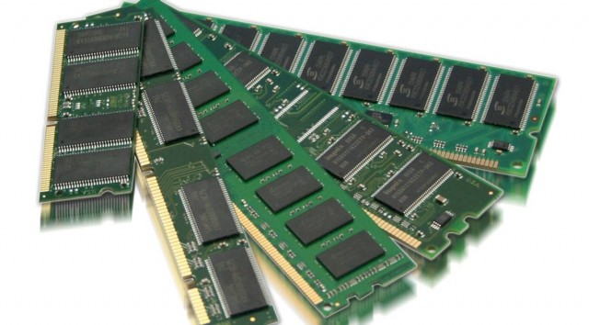
Six Categories of Hardware: 4. Processing
CPU: Hardware that interprets and executes software and coordinates all hardware.
RAM: Temporary holding area for information and software.

